Slide 1
Module 5 – Advanced Activities in Power Automate

Slide 2

Objective
Power Apps and Power Automate together.
Error handling.
Export and import flows.

Slide 3
Flow and PowerApps

Slide 4
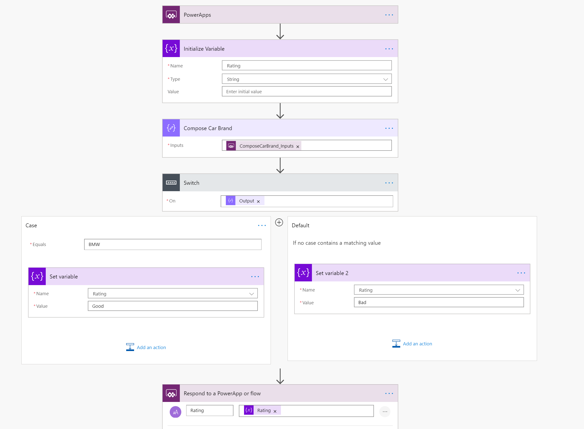


Start a Power Automate flow in PowerApps
Follow along
1. Call Flow
3. Return Data
2. Flow Process
Notes:
Follow along steps:
Logon to https://mail.powerapps.com
Logon to https://flow.microsoft.com
In Flow:
1. Create new Flow – Instant from Blank
2. Name it "PowerApp Car Rating" and select PowerApps as a trigger and click Create
3. Add step "Initialize Variable"
4. Name it Rating
5. Type String
6. Add step "Compose"
7. Rename it "Compose Car Brand"
8. Add Dynamic Content of "Ask in PowerApps"
9. Add step "Switch" and select "Output" Dynamic Content"
10. Configure Case and Default to match the screenshot above
11. Add step "Respond to a PowerApp or flow"
12. Put Rating then Rating Dynamic Content
https://docs.microsoft.com/en-us/powerapps/using-logic-flows

Slide 5
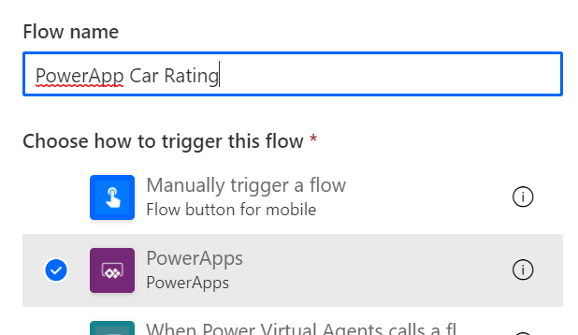
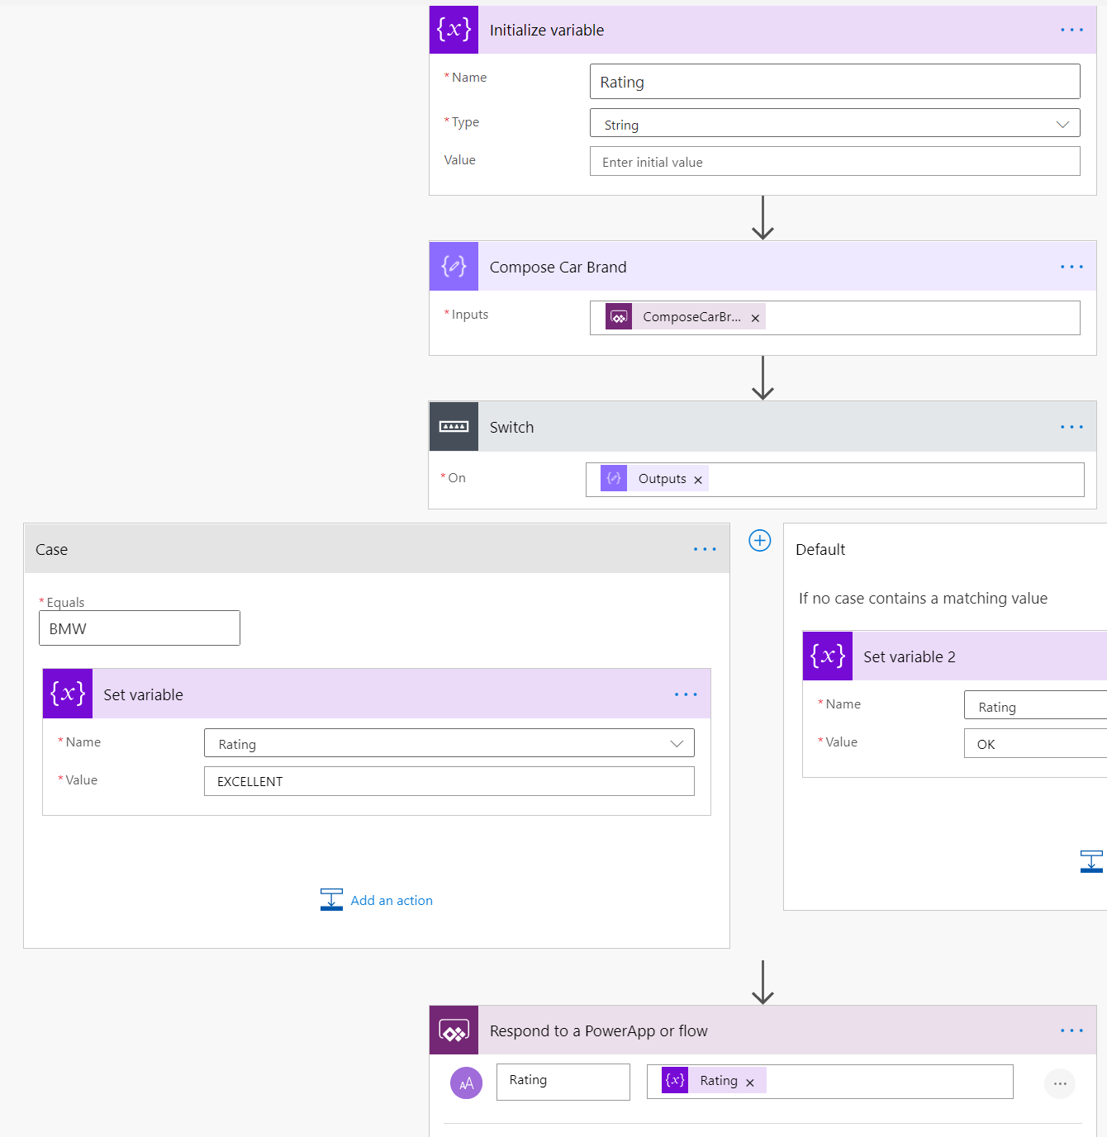
Lab 1 - Start a flow in PowerApps
Follow along
Open https://flow.microsoft.com and create new “Instant cloud flow” named “PowerApp Car Rating” and select “PowerApps” trigger
Add new step “Initialize variable” - Name:Rating, Type:String
Add new step “Compose” and rename action to “Compose Car Brand”
Inputs: [Ask in PowerApps] (dynamic content)
Add new step “Switch” (Control)
Case: BMW
Add new “Set variable” step to Case branch and select Rating variable and set its value to EXCELLENT
Add new “Set variable” step to Default branch and select Rating variable and set its value to OK
Add new step “Respond to a PowerApp or Flow”
Add new Text Input named “Rating” and set its value to Rating variable
Open https://make.powerapps.com

Slide 6
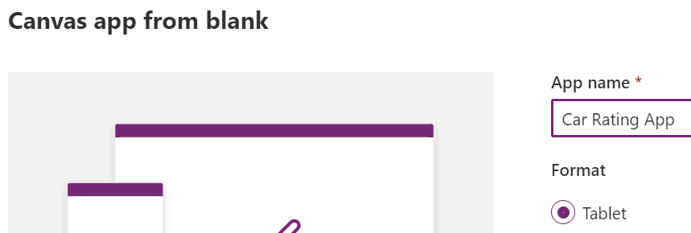
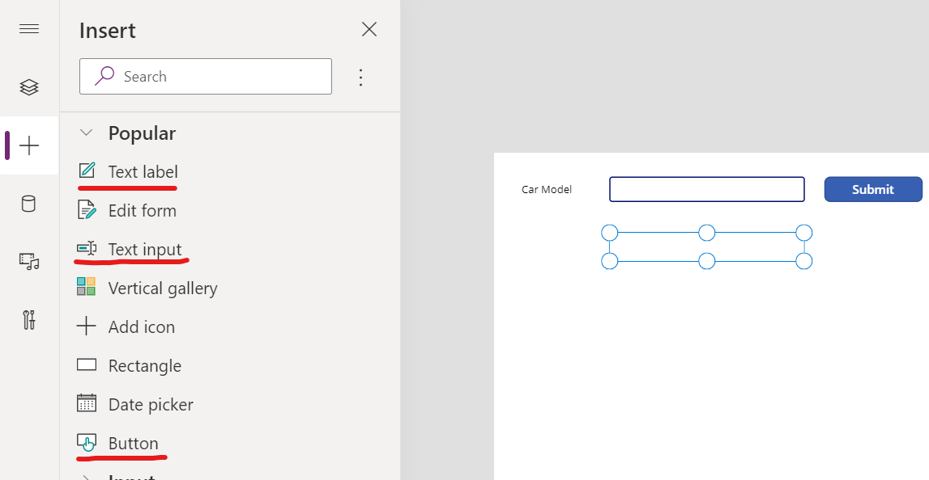
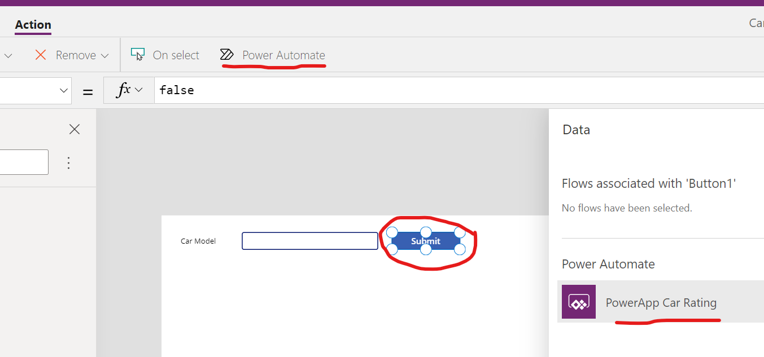
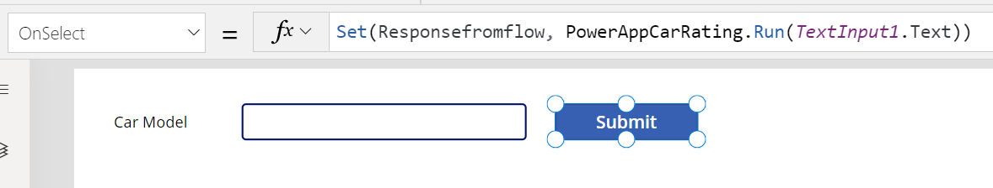
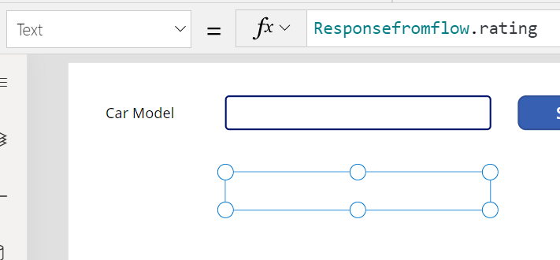

Lab 1 - Start a flow in PowerApps
Follow along
Create new Canvas app from blank with Tablet layout and name the app as “Car Rating App”
Add following controls to screen
Text label: “Car Model”
Text input
Button: “Submit”
Text label: “”
Select Button and attach your Flow to it Action > Power Automate > “PowerApp Car Rating”
Set Button’s OnSelect: Set(Responsefromflow, PowerAppCarRating.Run(TextInput1.Text))
Select the second Text label (under text input) and set its Text: Responsefromflow.rating
Test the App by clicking Play button on top right corner
Test app by typing “BMW” to textbox and press Submit. Test with other car brands as well

Slide 7
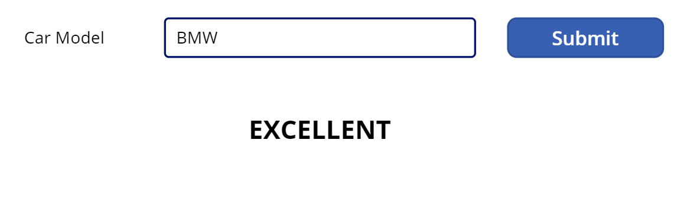
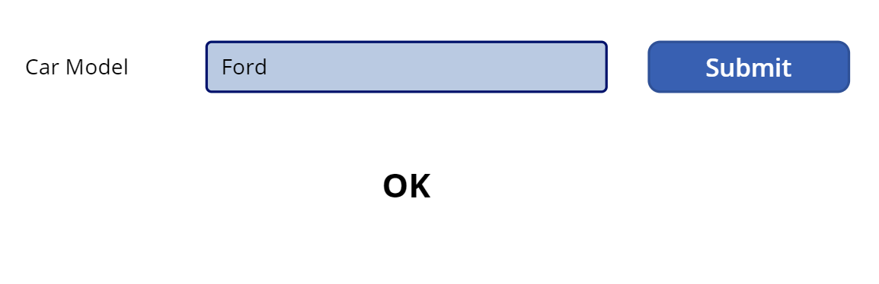
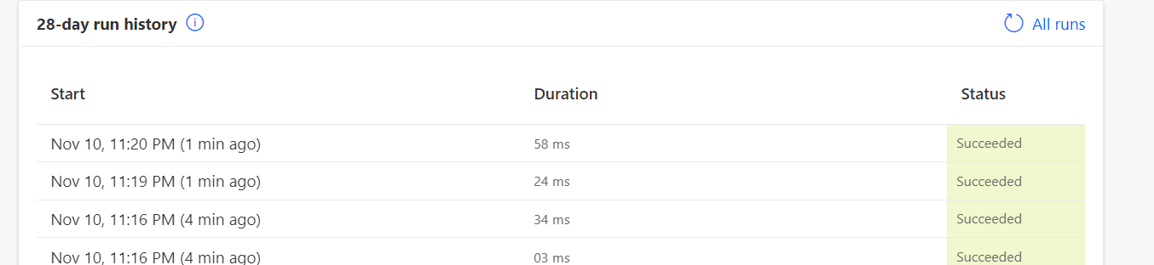
Lab 1 - Start a flow in PowerApps
Follow along
1. Call Flow
3. Return Data
2. Flow Process

Slide 8
Advanced actions

Slide 9
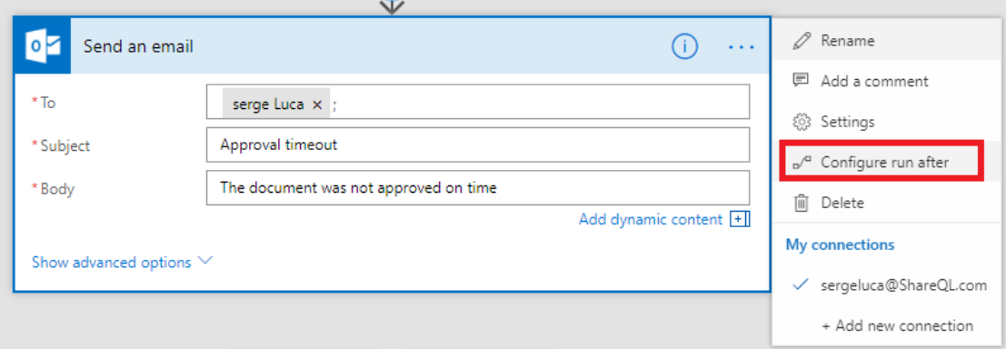
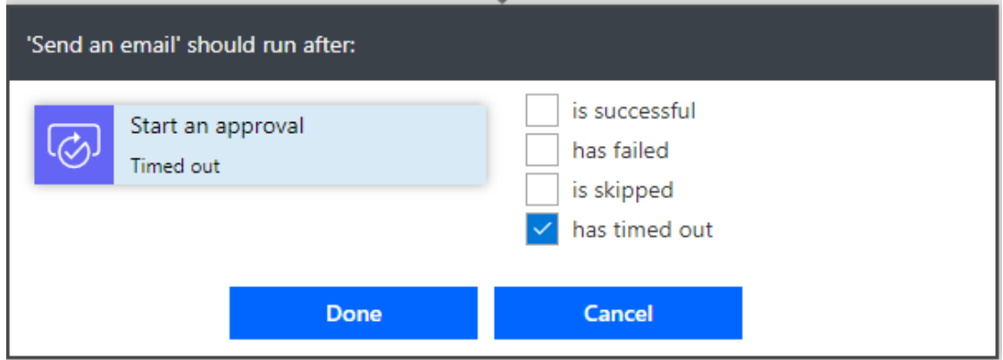
Error handling: use “Configure run after”
Flow run time is limited to 30 days

Slide 10
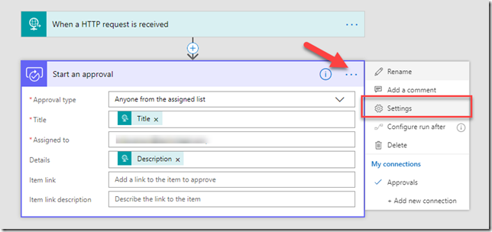
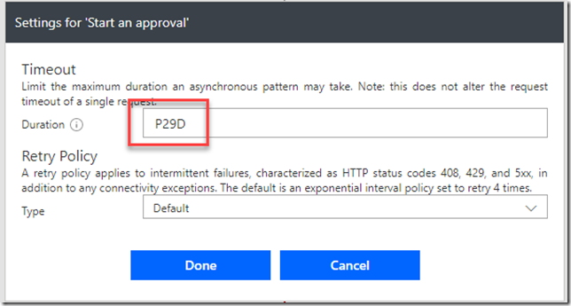
Approval expiring
The default max timeout is 30 days in Microsoft Flow.
But you can change the timeout.
If you set the action timeout to 29 days it’s guaranteed to timeout before the whole flow times out. To test it out you can set the timeout lower, for example 15 minutes (PT15M).

Slide 11
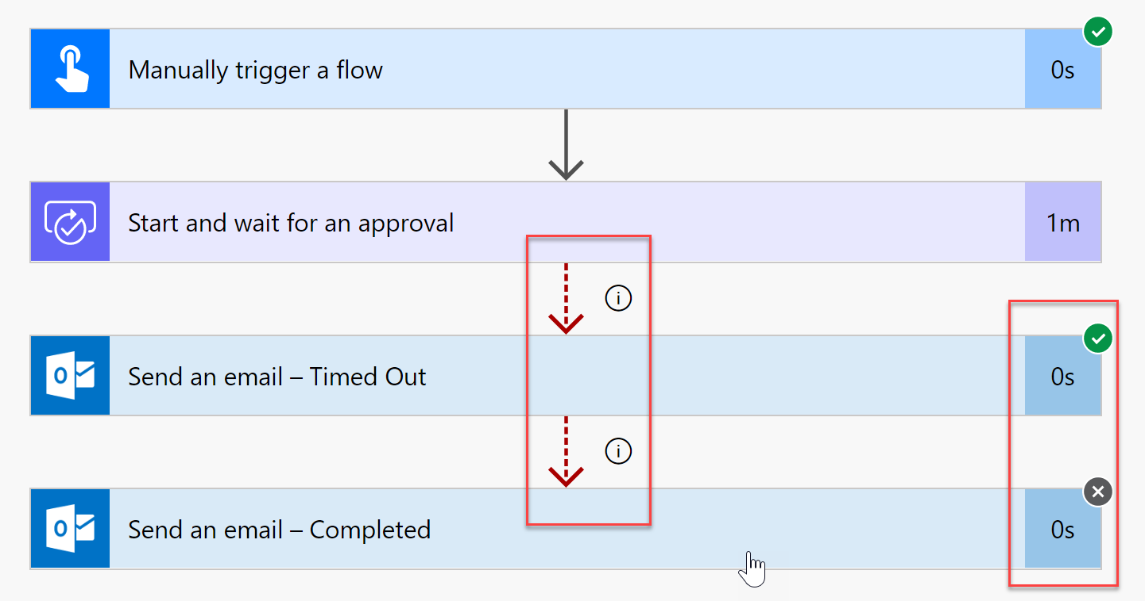
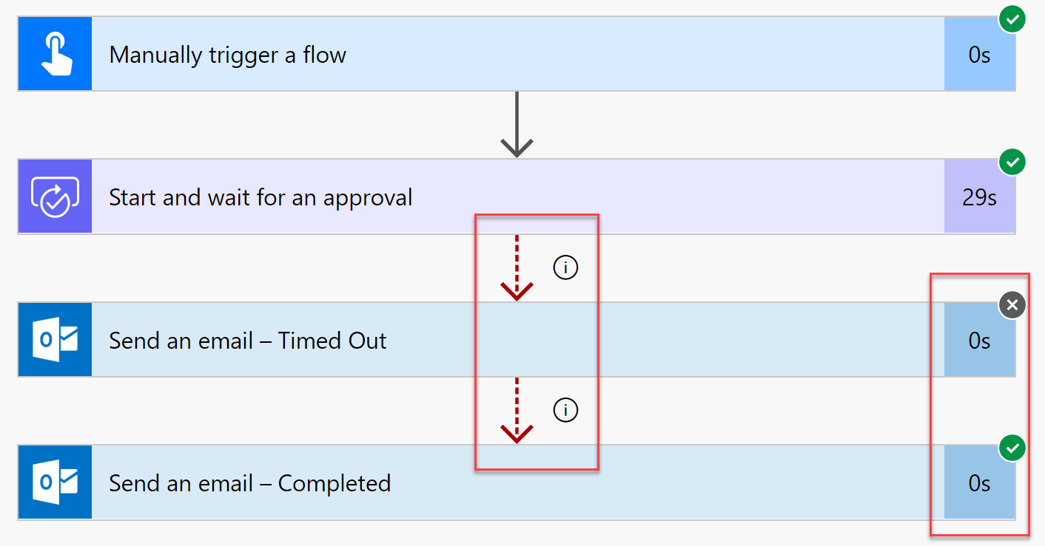
Error handling

Slide 12
Export & Import Flow

Slide 13
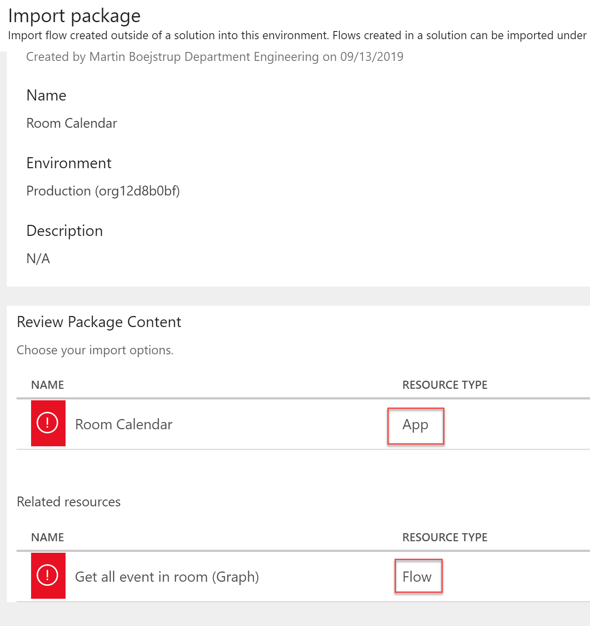
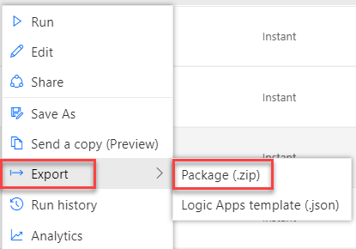
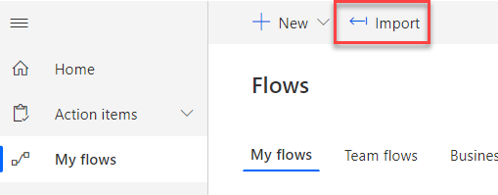
Export & import Flow Package
Follow along
A Flow package can also contain PowerApps if they are connected.
Notes:
Follow along steps: ​
Show how to export and import flow package

